Slide 1

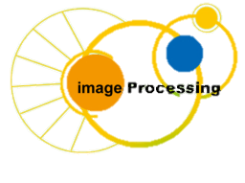
C Programing
Prof. John Y. Chiang
Dept. of Computer Science & Engineering
National Sun Yat-sen University
chiang@cse.nsysu.edu.tw
http://image.cse.nsysu.edu.tw

Slide 2
Contents
1 C Overview
2 Selection and Decision
3 Repetition and Loops
4 Function
5 Arrays
6 Pointers I
7 Pointers II
8 Structure
9 Link list
10 Class and object
I Number system

Slide 3
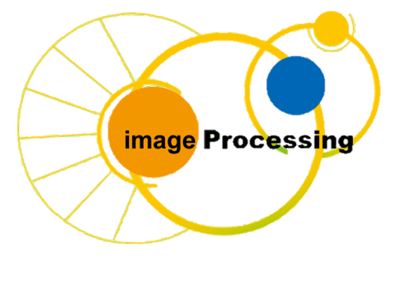
Lecture I
Number system

Slide 4
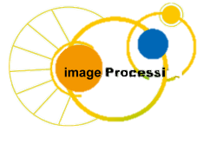
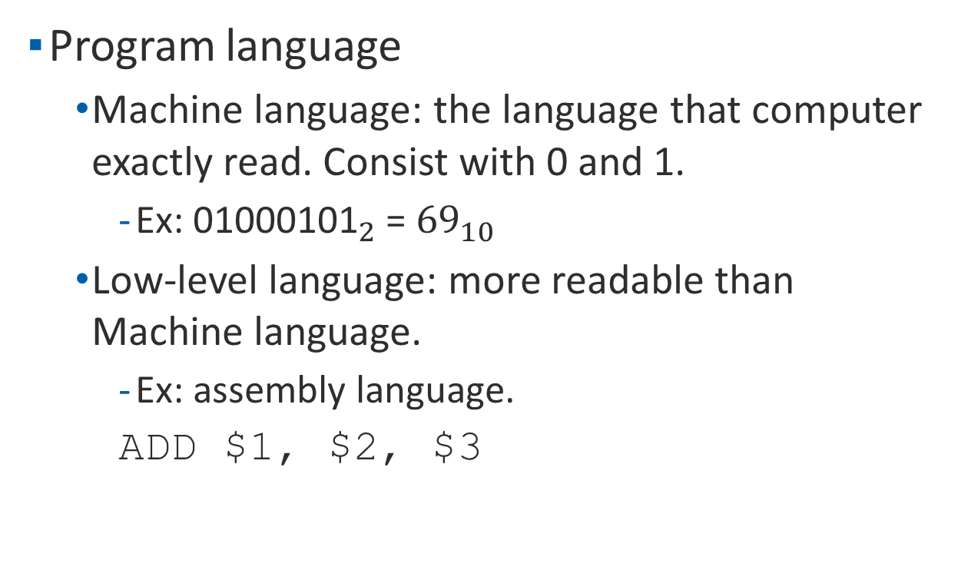
Introduction
Program language
    Machine language: the language that computer exactly read. Consist with 0 and 1.
        Ex: ${\text{01000101}}_{2}$ = ${\text{69}}_{10}$
    Low-level language: more readable than Machine language.
        Ex: assembly language.
        ADD $1, $2, $3

Slide 5
Introduction
    High-level language: which the programmer usually use for coding.
        Ex: C, Java, C++, Python...
    Other language
        Ex: MATLAB, MAPLE, R...

Slide 6
Source code to machine code
int i = 5;
float f = 10;
...
011110000011001010100111010101000111001010
...
Source code
Machine code

Slide 7
Bits and Bytes
Bit: only consists with one 0 or 1.
    1 bit: 0, 1.
    2 bits: 00, 01, 10, 11.
    3 bits: 000, 001, 010, ..., 110, 111
Byte: consist with eight bits.
    1 byte: 00101011.
Bytes are used to consist each data type in C or other language.

Slide 8
Base of the numeral system
There are many kinds of base for number system. Such as base 2, base 8, base 10, base 16. The most common is base 10.
One base can change to another base undoubtedly.
The number stored in memory is base 2.

Slide 9
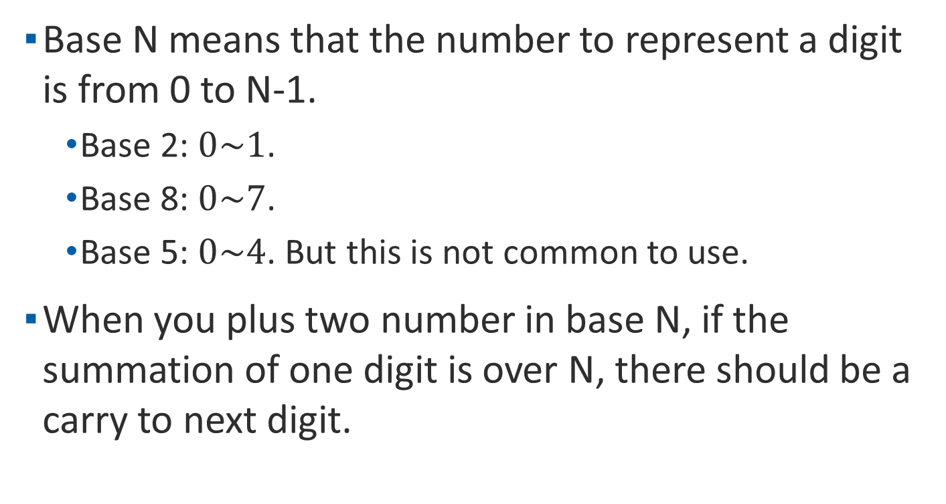
Base of the numeral system
Base N means that the number to represent a digit is from 0 to N-1.
    Base 2: $0\sim 1$.
    Base 8: $0\sim 7$.
    Base 5: $0\sim 4$. But this is not common to use.
When you plus two number in base N, if the summation of one digit is over N, there should be a carry to next digit.

Slide 10
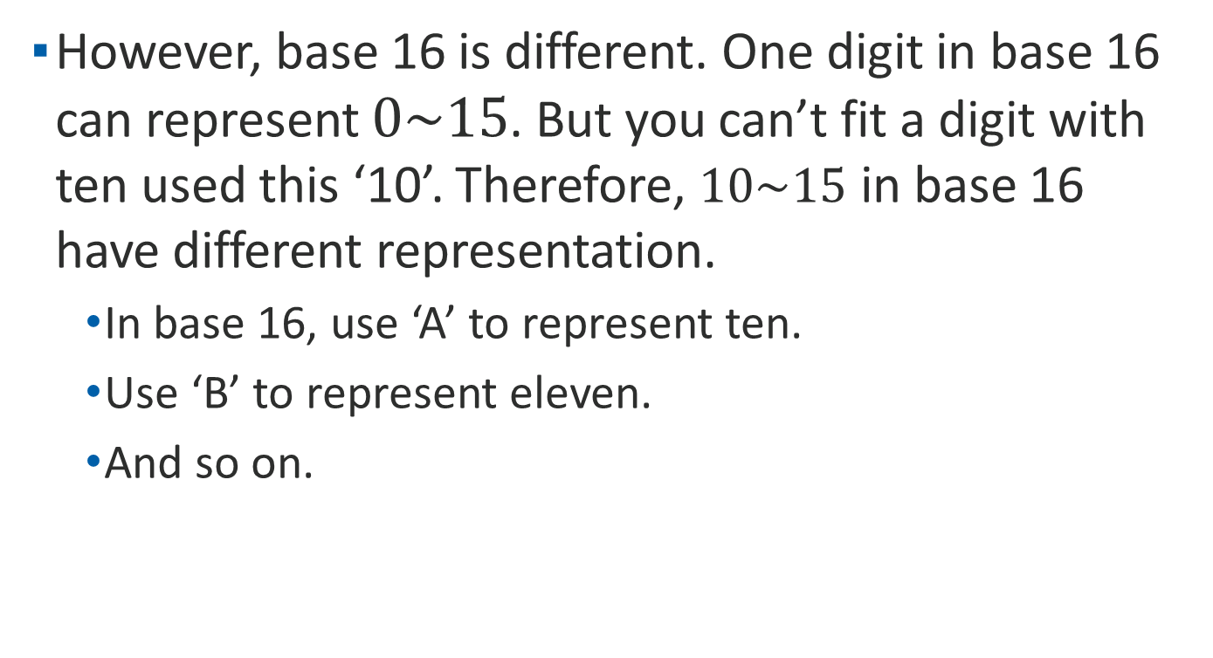
Base of the numeral system
However, base 16 is different. One digit in base 16 can represent $0\sim 15$. But you can’t fit a digit with ten used this ‘10’. Therefore, $10\sim 15$ in base 16 have different representation.
    In base 16, use ‘A’ to represent ten.
    Use ‘B’ to represent eleven.
    And so on.

Slide 11
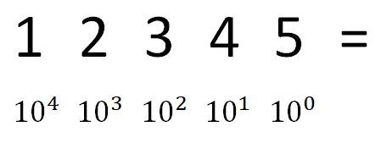
Base 10(decimal)
The number system we use today.
A number can be changed to the exponent format.
Other base can use the exponent format to convert to decimal.

Slide 12
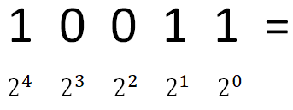

Base 2(Binary)
The number system computer use.
It is easily convert binary to decimal.

Slide 13
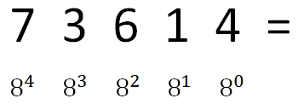
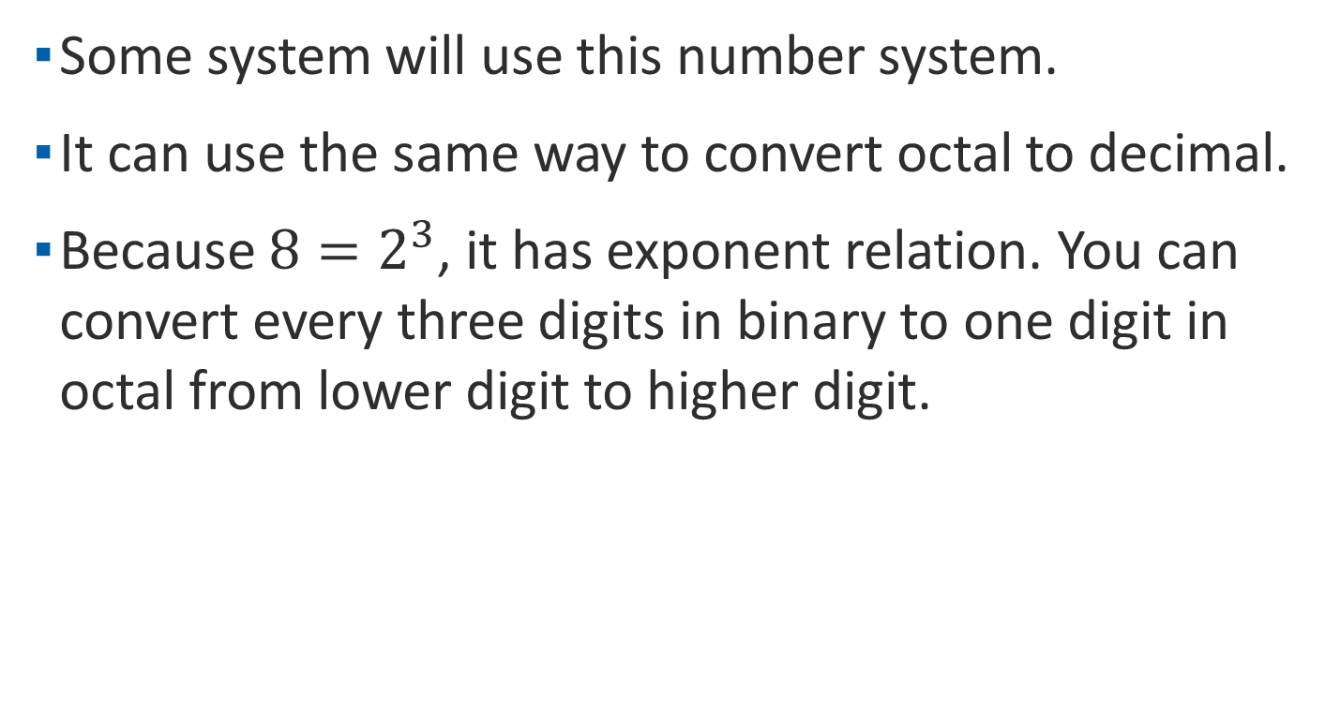
Base 8(Octal)
Some system will use this number system.
It can use the same way to convert octal to decimal.
Because $8=2^{3}$, it has exponent relation. You can convert every three digits in binary to one digit in octal from lower digit to higher digit.

Slide 14







Base 8(Octal)
Ex:
$2^{2}$ = 4
$2^{1}$ = 2
$2^{2}$ = 4
$2^{1}$ = 2
$2^{2}+2^{0}$= 5
4 2 4 2 5 =
16384 + 1024 + 256 + 16 + 5 = 17685
$8^{4}$ $8^{3}$ $8^{2}$ $8^{1}$ $8^{0}$

Slide 15
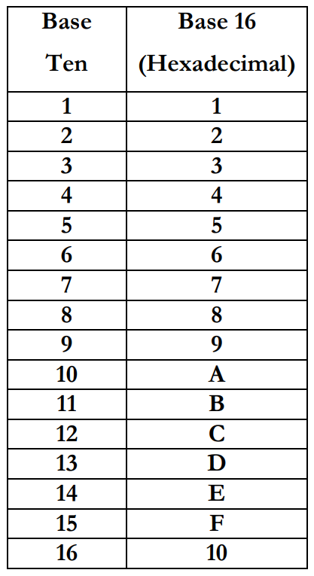
Base 16(Hex)
Memory address usually use this system to express.
It use A~F to represent ten to fifteen(10~15)

Slide 16
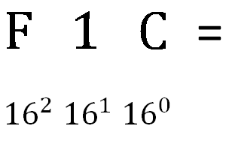
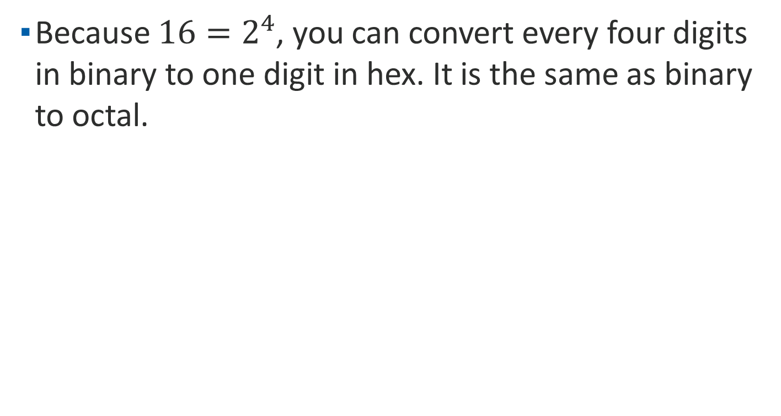
Base 16(Hex)
Because $16=2^{4}$, you can convert every four digits in binary to one digit in hex. It is the same as binary to octal.

Slide 17




Base 16(Hex)
Ex:
$2^{2}$ = 4
$2^{2}+ 2^{0}$ = 5
$2^{0}$ = 1
$2^{2}+2^{0}$= 5
4 5 1 5 =
16384 + 1280 + 16 + 5 = 17685
${16}^{3}$ ${16}^{2}$ ${16}^{1}$ ${ 16}^{0}$

Slide 18
Inversion between base
It is easily to convert base 2, 8, 16 to base 10 with the exponent calculation.
From base 2 to base 8, 16, what you need is to merge the digits in base 2 to one digit in higher base.
If you want to convert base 8 to 16 or reverse, converting to base 2 then to the base you need is recommended.

Slide 19
Inversion between base
Convert to base 10 is easy. However, it is a little complex convert decimal to others.
The process of converting has two parts: integer part and fractional part.
Integer part is using a division method which keeps track of remainders and progressively divides by the desired base.
The fractional part uses a multiple method which keeps track of integers and progressively multiply by the desired base.

Slide 20
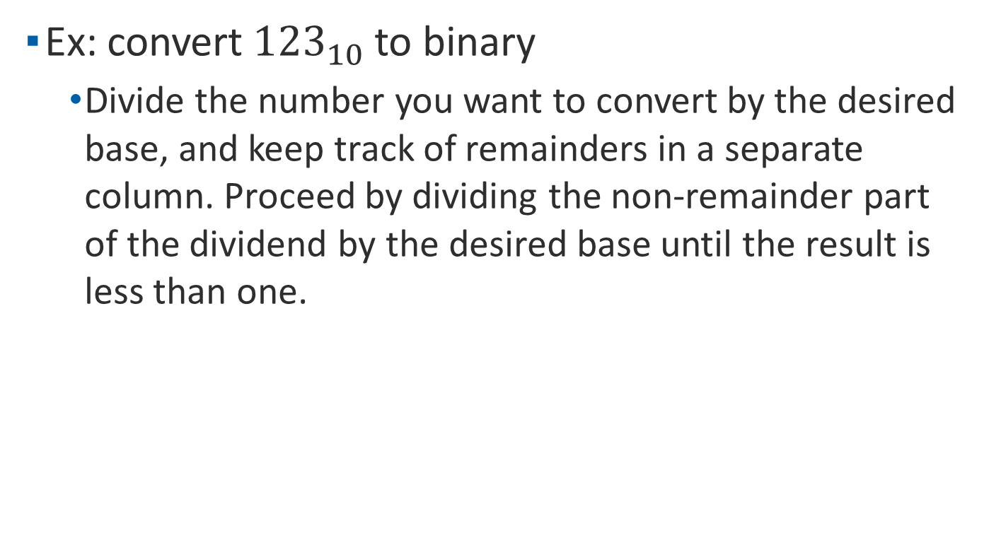
Inversion between base
Ex: convert ${123}_{10}$ to binary
    Divide the number you want to convert by the desired base, and keep track of remainders in a separate column. Proceed by dividing the non-remainder part of the dividend by the desired base until the result is less than one.

Slide 21
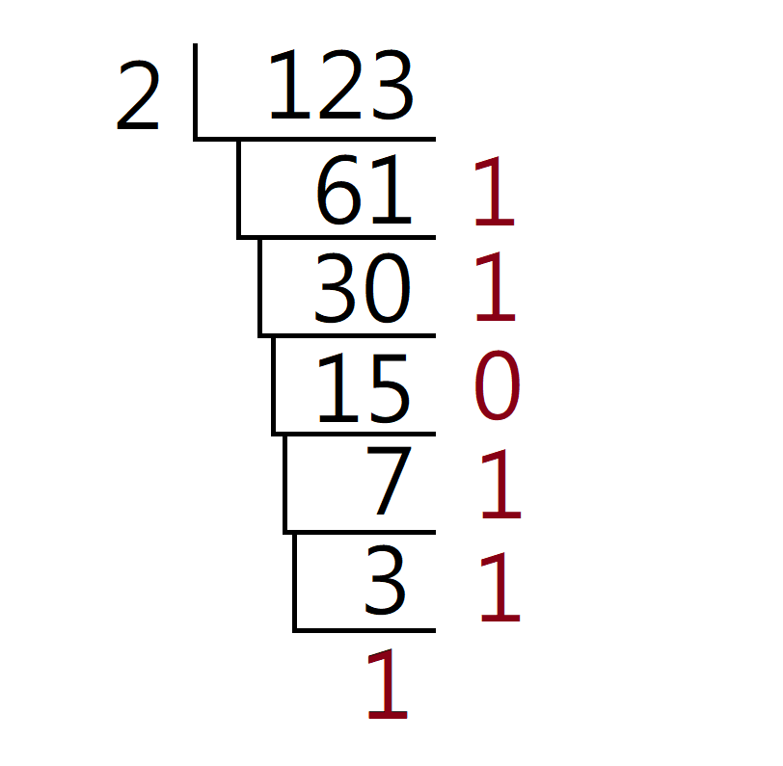
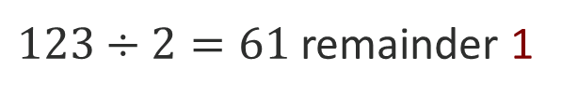
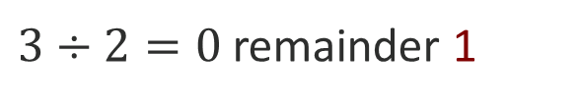
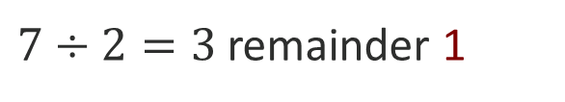
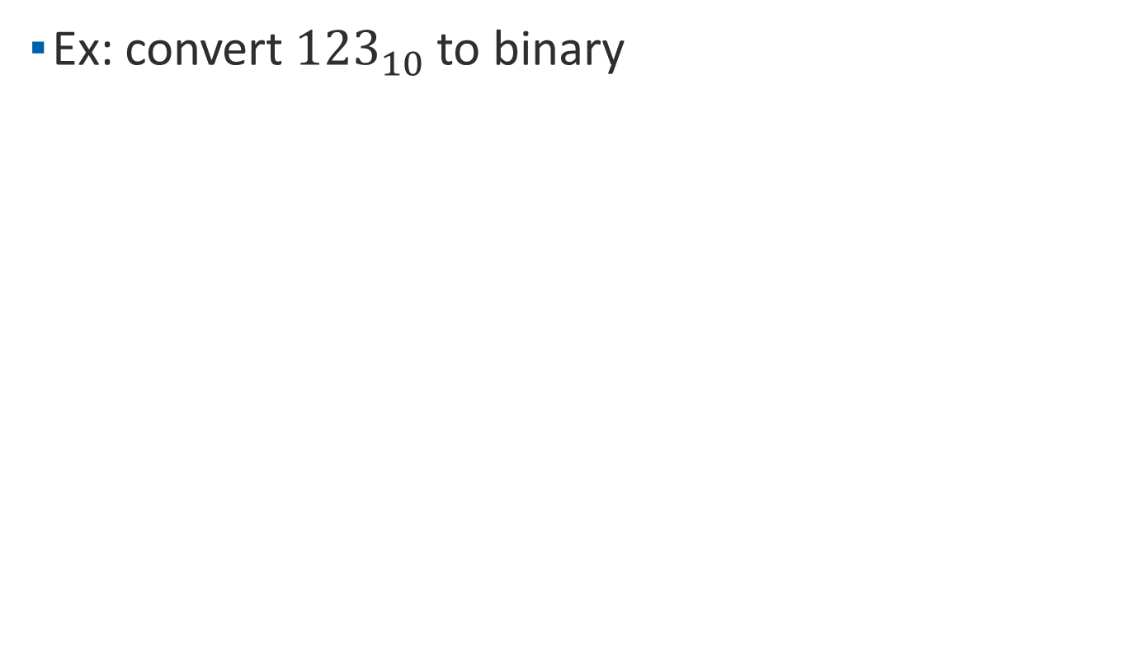
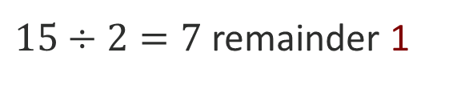
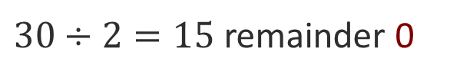
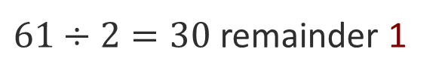
Inversion between base
Ex: convert ${123}_{10}$ to binary
$123÷2=61$ remainder 1
$61÷2=30$ remainder 1
$30÷2=15$ remainder 0
$15÷2=7$ remainder 1
$7÷2=3$ remainder 1
$3÷2=0$ remainder 1

Slide 22
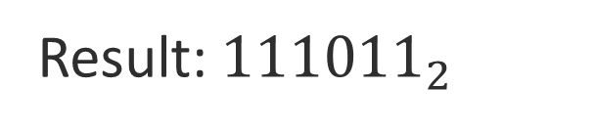
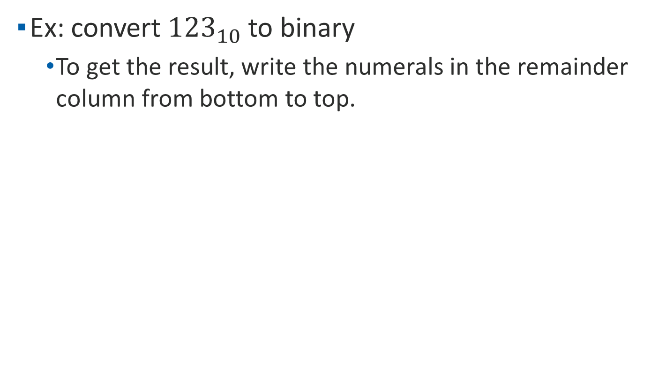
Inversion between base
Ex: convert ${123}_{10}$ to binary
    To get the result, write the numerals in the remainder column from bottom to top.
Result: ${111011}_{2}$

Slide 23
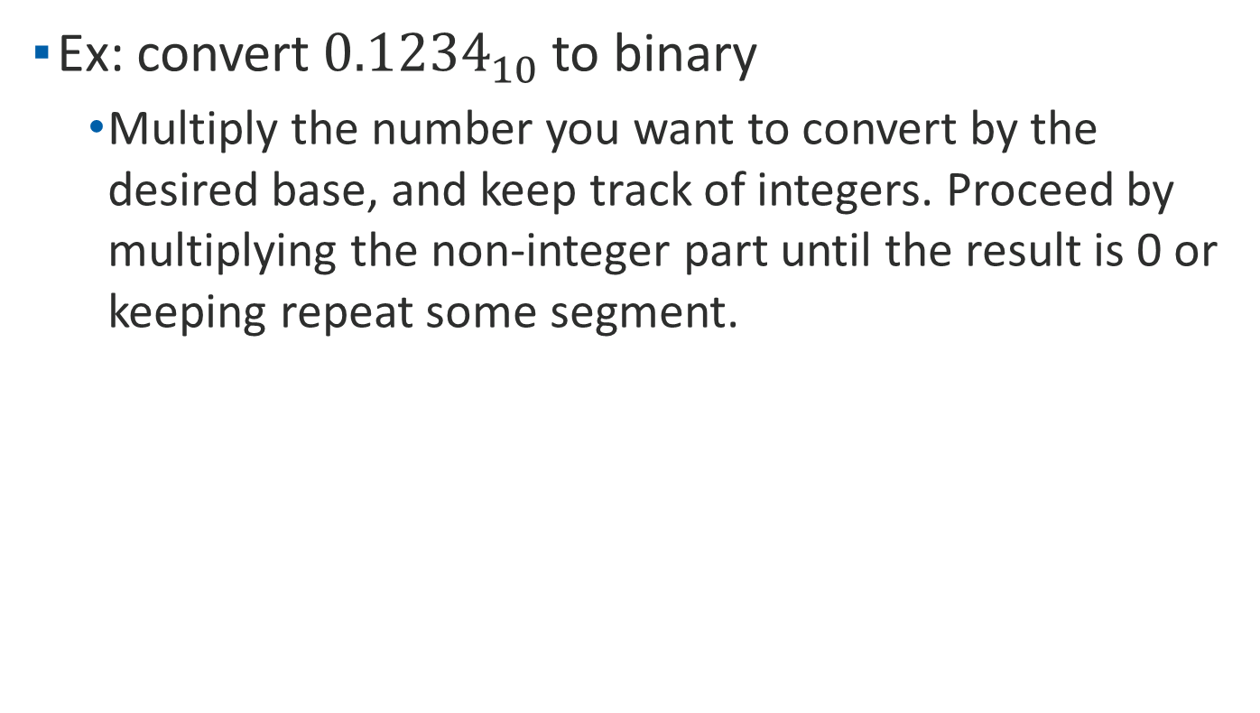
Inversion between base
Ex: convert ${0.1234}_{10}$ to binary
    Multiply the number you want to convert by the desired base, and keep track of integers. Proceed by multiplying the non-integer part until the result is 0 or keeping repeat some segment.

Slide 24
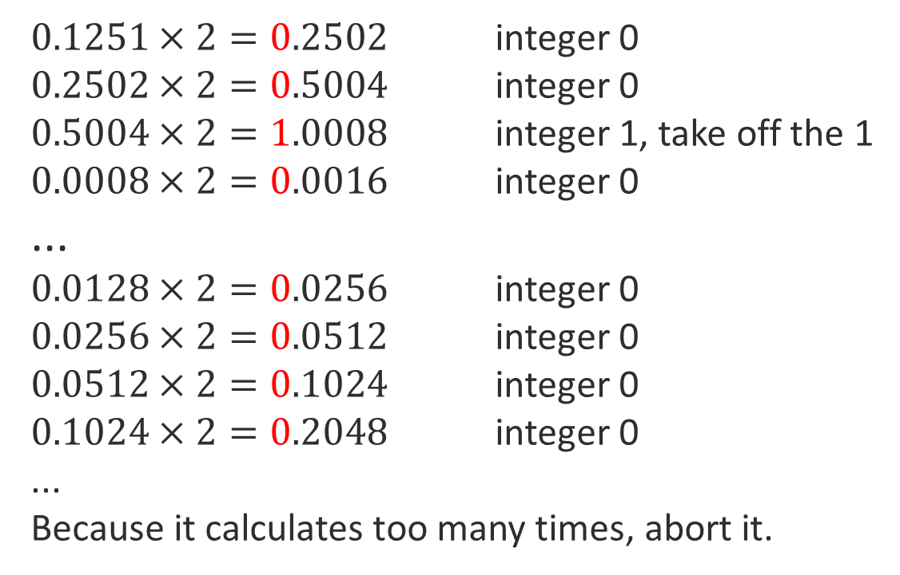
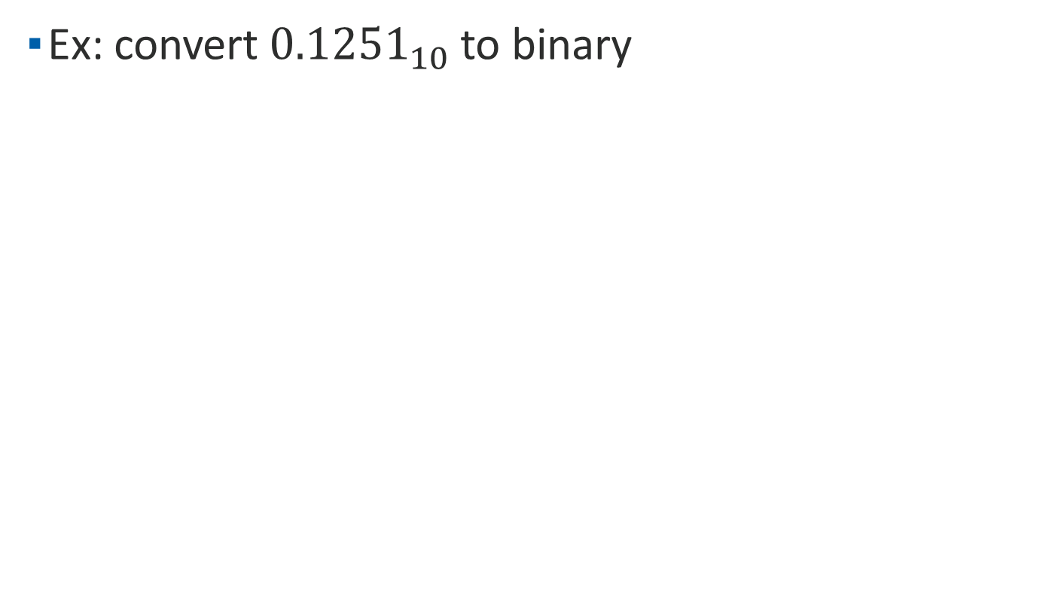
Inversion between base
Ex: convert ${0.1251}_{10}$ to binary
$0.1251×2=0.2502$ integer 0
$0.2502×2=0.5004$ integer 0
$0.5004×2=1.0008$ integer 1, take off the 1
$0.0008×2=0.0016$ integer 0
...
$0.0128×2=0.0256$ integer 0
$0.0256×2=0.0512$ integer 0
$0.0512×2=0.1024$ integer 0
$0.1024×2=0.2048$ integer 0
...
Because it calculates too many times, abort it.

Slide 25

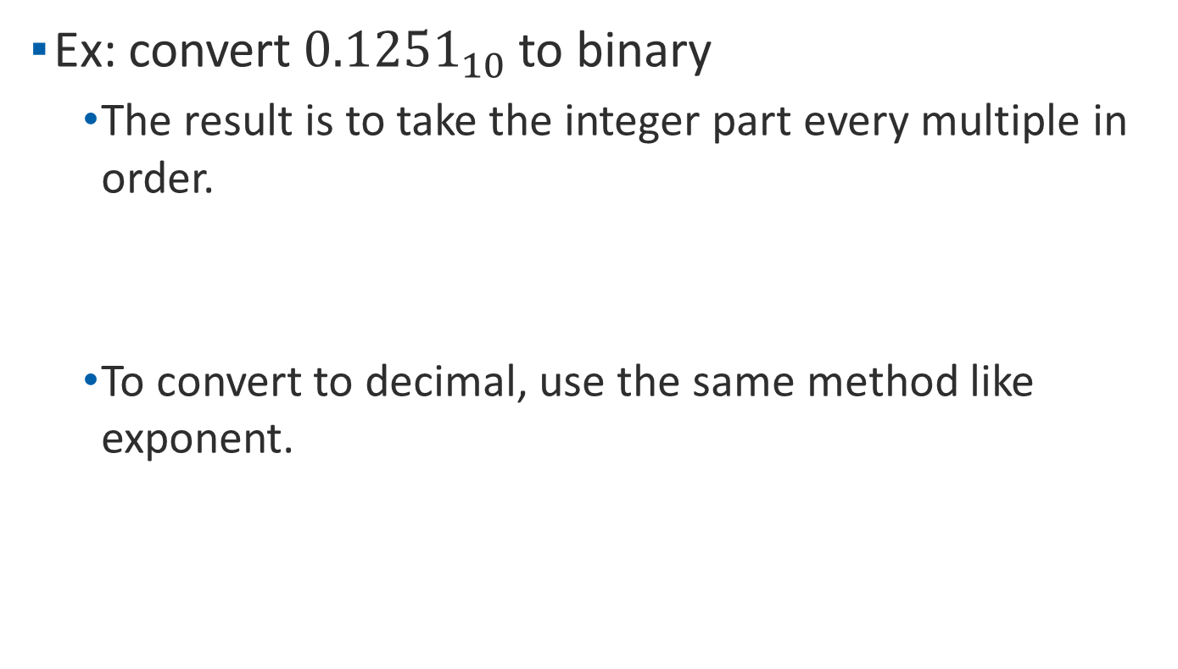

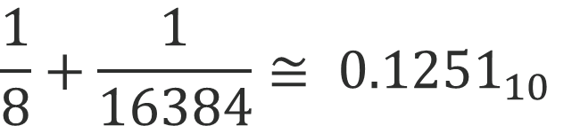
Inversion between base
Ex: convert ${0.1251}_{10}$ to binary
    The result is to take the integer part every multiple in order.
    To convert to decimal, use the same method like exponent.
${0.1251}_{10}$ ${0.00100000000001}_{2}$
$${0.00100000000001}_{2}$$
$${\frac{1}{8}+\frac{1}{16384}≅ 0.1251}_{10}$$
$2^{−3}$ $2^{−14}$

Slide 26
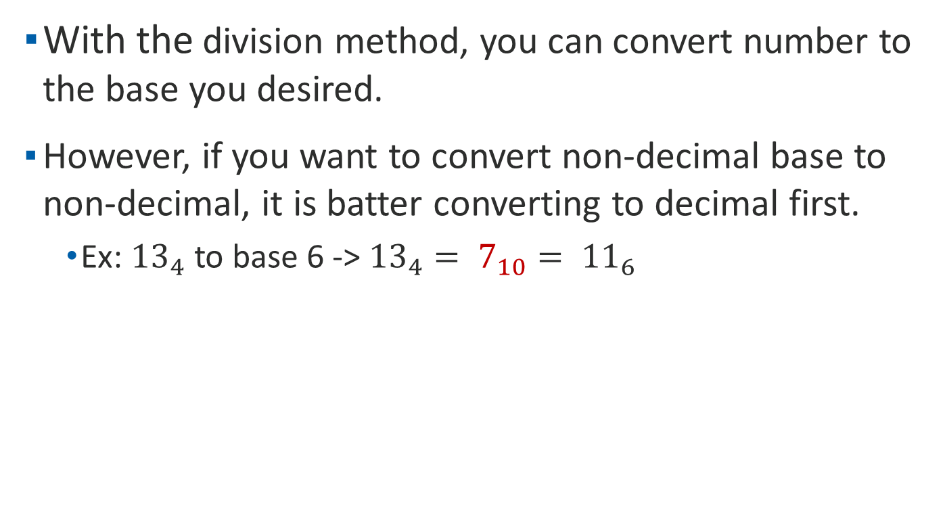
Inversion between base
With the division method, you can convert number to the base you desired.
However, if you want to convert non-decimal base to non-decimal, it is batter converting to decimal first.
    Ex: ${13}_{4}$ to base 6 -> ${13}_{4}= 7_{10}= {11}_{6}$

Slide 27
1’s complement and 2’s complement
It is another way to represent the number in binary.
The ones' complement of the number then behaves like the negative of the original number in some arithmetic operations.
Because of the feature, it can perform subtraction with adder in circuit.

Slide 28
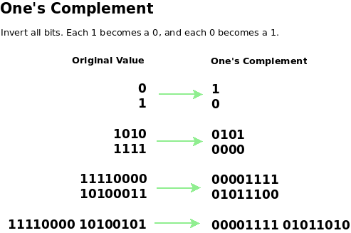
1’s complement
If all bits in a byte are inverted by changing each 1 to 0 and each 0 to 1, we have formed the one’s complement of the number.

Slide 29
2’s complement
The two’s complement is a method for representing positive and negative integer values in binary.
The useful part of two’s complement is that it automatically includes the sign bit.
To form the two’s complement, add 1 to the one’s complement.

Slide 30
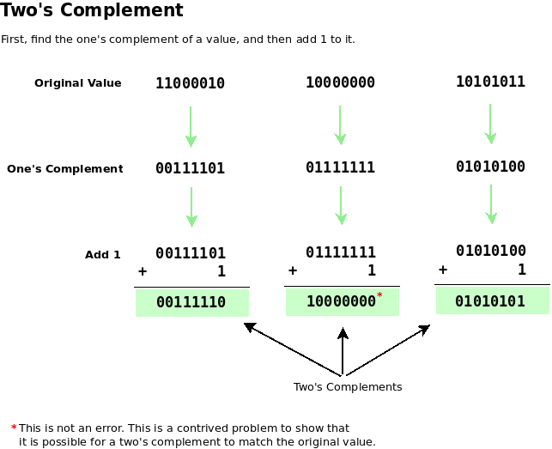
2’s complement

Slide 31
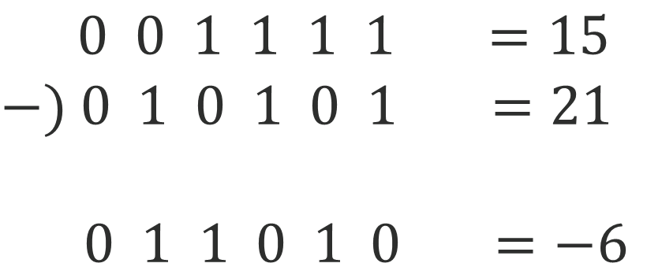
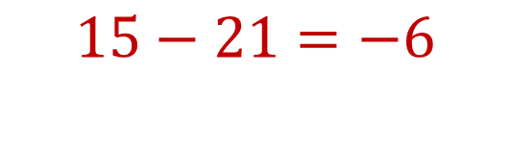
2’s complement
If we calculate the formula below:
It should be wrote like this:
    $$15−21=−6$$
    $0 0 1 1 1 1 =15$
    $$−) 0 1 0 1 0 1 =21$$
$0 1 1 0 1 0 =−6$

Slide 32
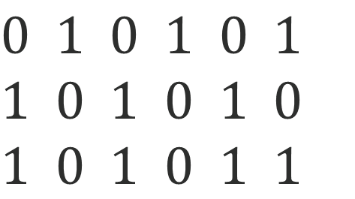

2’s complement
However, if we calculate the formula with 2’s complement, it will change to :
Change the 21 to (-21) with 2’s complement first.
    $$15+(−21)=−6$$
    $0 1 0 1 0 1$
    $$1 0 1 0 1 0$$
    $1 0 1 0 1 1$
    Original value
    1’s complement
    2’s complement

Slide 33
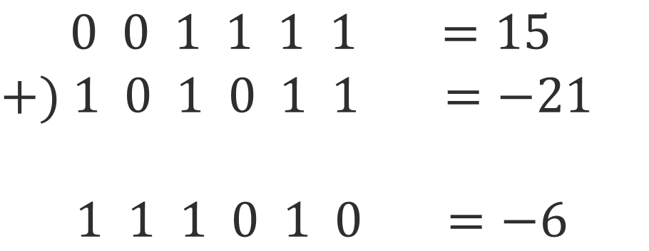

2’s complement
After changed, we calculate the formula again:
It will become this:
    $$15+(−21)=−6$$
    $0 0 1 1 1 1 =15$
    $$+) 1 0 1 0 1 1 =−21$$
$1 1 1 0 1 0 =−6$

Slide 34
Data Types
Data type: A set of values and a set of operations defined for those values.
The four standard types in C:
    Int
    Float
    Double
    Char
Each Data type has different size.

Slide 35
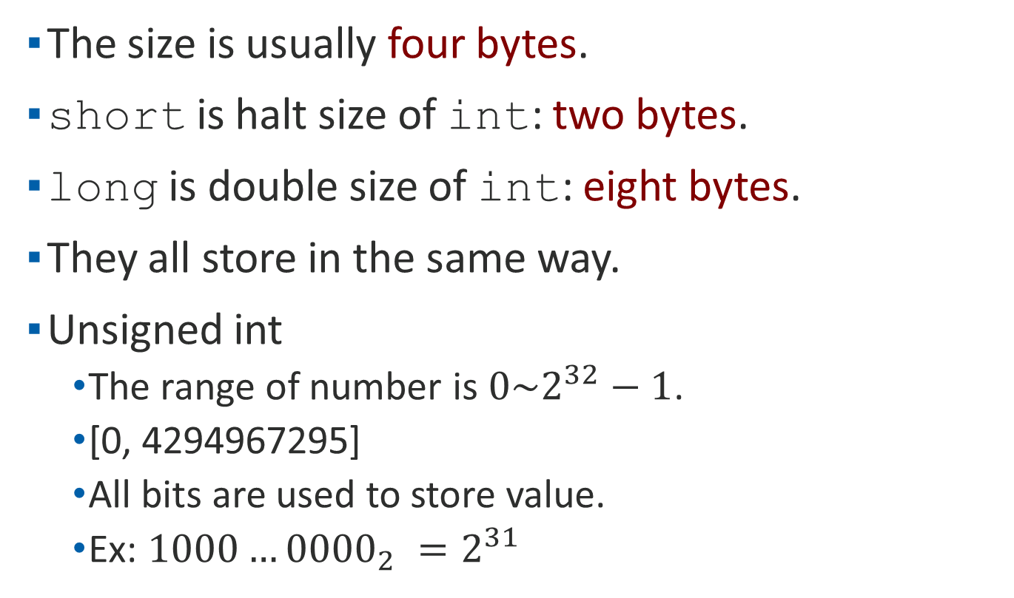
Int
The size is usually four bytes.
short is halt size of int: two bytes.
long is double size of int: eight bytes.
They all store in the same way.
Unsigned int
    The range of number is $0\sim 2^{32}−1$.
    [0, 4294967295]
    All bits are used to store value.
    Ex: ${1000…0000}_{2} =2^{31}$

Slide 36
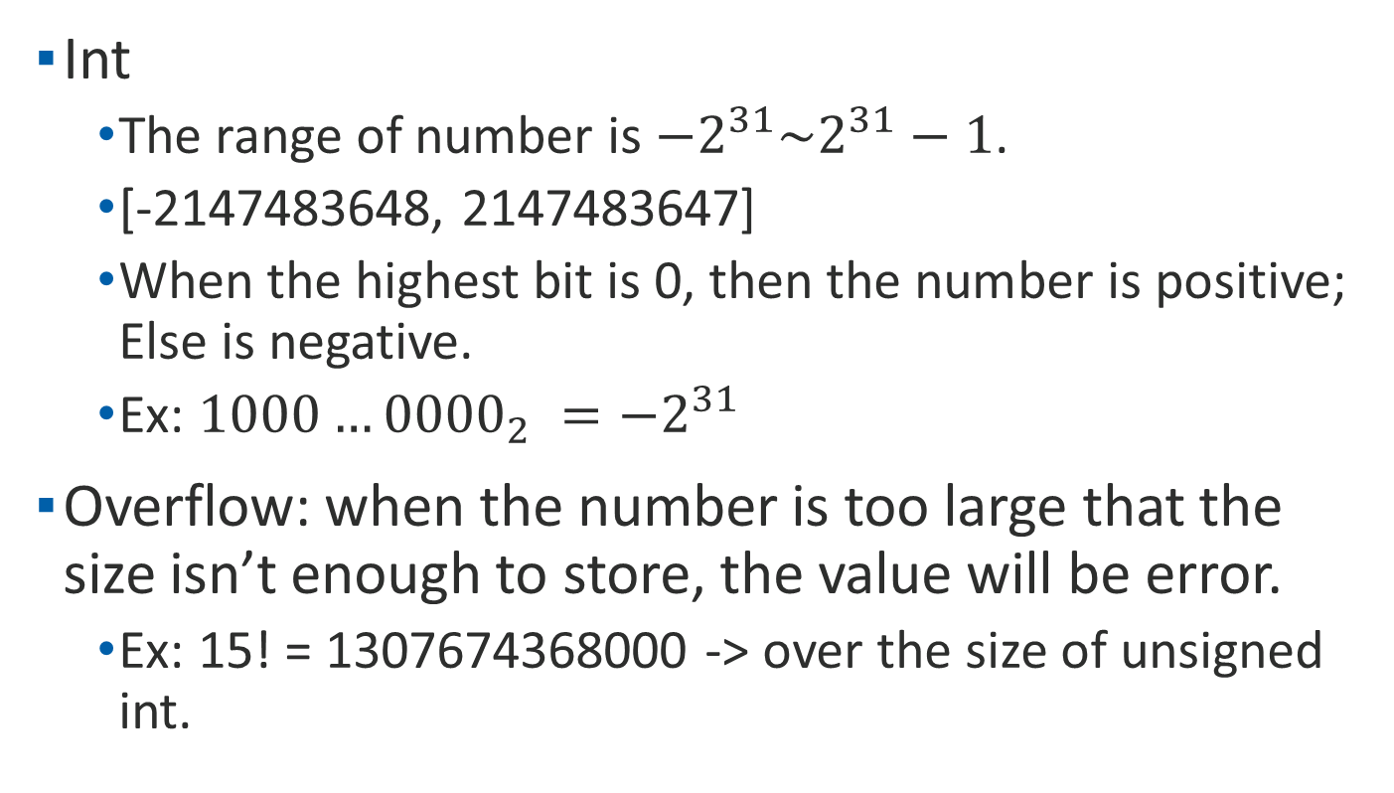
Int
Int
    The range of number is $−2^{31}\sim 2^{31}−1$.
    [-2147483648, 2147483647]
    When the highest bit is 0, then the number is positive; Else is negative.
    Ex: ${1000…0000}_{2} ={−2}^{31}$
Overflow: when the number is too large that the size isn’t enough to store, the value will be error.
    Ex: 15! = 1307674368000 -> over the size of unsigned int.

Slide 37
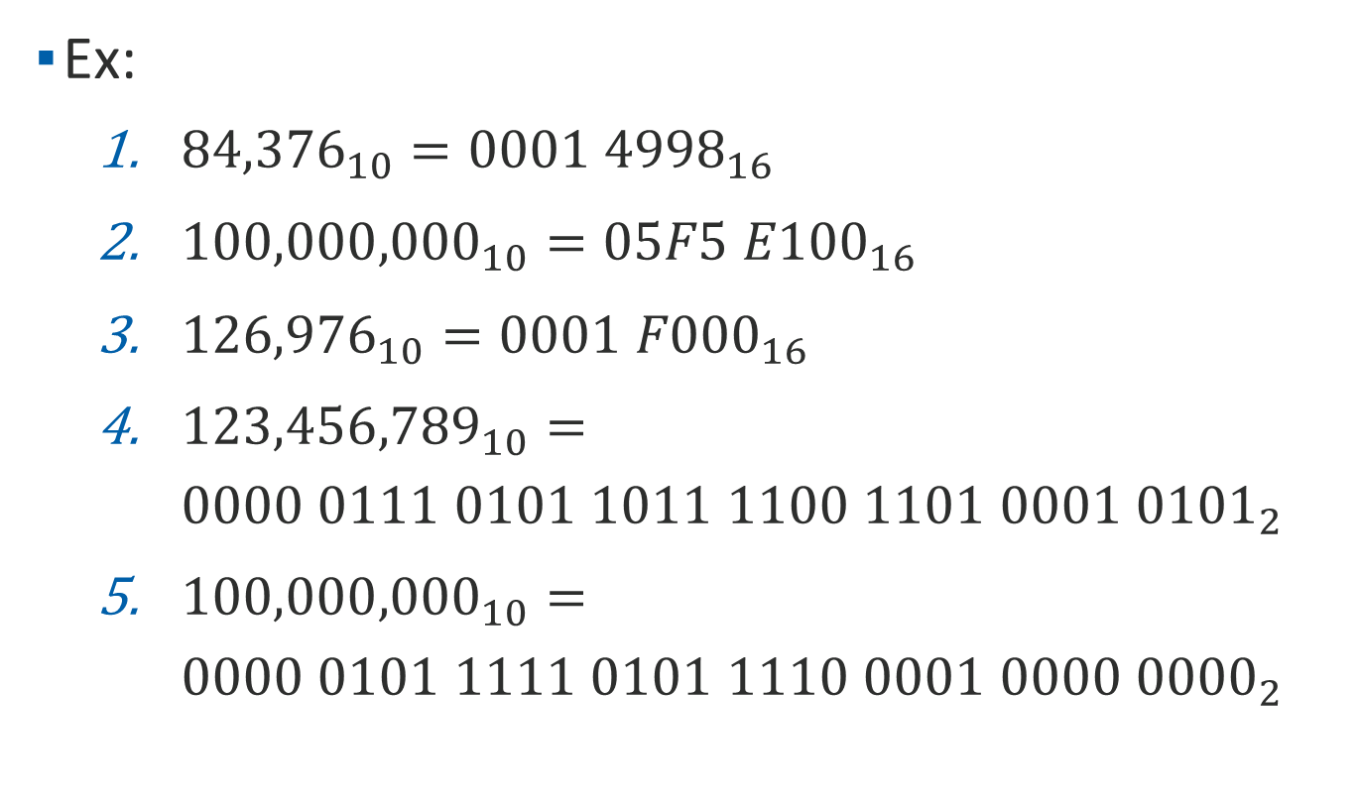
Int
Ex:
    ${84,376}_{10}={0001 4998}_{16}$
    ${100,000,000}_{10}={05F5 E100}_{16}$
    ${126,976}_{10}={0001 F000}_{16}$
    ${123,456,789}_{10}={0000 0111 0101 1011 1100 1101 0001 0101}_{2}$
    ${100,000,000}_{10}={0000 0101 1111 0101 1110 0001 0000 0000}_{2}$

Slide 38
Float
The size is usually four bytes.
double is double size of float: eight bytes.
The computer stores the float in a special format rather than the int.
The format is called IEEE-754

Slide 39
IEEE-754
IEEE-754 has three part:
    S(Signed): to decide whether the number is positive or negative.
    E(Exponent): to normalize the format of the value. Usually to binary.
    F(Fraction): the value after normalized.
The size of float and double are different.
IEEE-754 (float)
Field | S | E | F
Bits | 1 | 8 | 23
IEEE-754 (double)
Field | S | E | F
Bits | 1 | 11 | 52

Slide 40
How to convert to IEEE-754
Take -123.125 for example.
Step 1: set S.
    Check the value is positive or negative.
    Positive: set S = 0.
    Negative: set S = 1.

Slide 41
How to convert to IEEE-754
Step 2: change the value from decimal to binary.
    The part before the decimal point should be kept dividing by 2 until it lefts only 0 or 1. You will get a sequence of 0/1 remainders. The result is the reverse of sequence.
Result: 111011

Slide 42

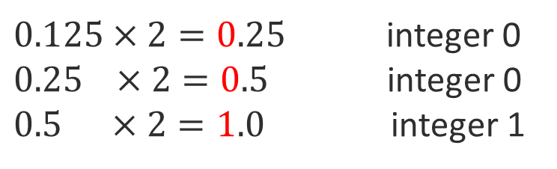
How to convert to IEEE-754
Step 2: change the value from decimal to binary.
    The part after the decimal point should be kept multiplying by 2. Each times you multiply, get each digit as an integer parts. The result is usually approximately.
$0.125×2=0.25$ integer 0
$0.25 ×2=0.5$ integer 0
$0.5 ×2=1.0$ integer 1
${0.125}_{10}$ ${0.001}_{2}$

Slide 43
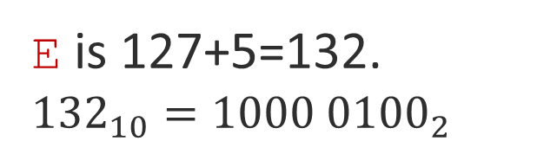


How to convert to IEEE-754
Step 3: calculate the E and F.
    Move the decimal point forward until left one digit before it and calculate the times. Finally, the times plus 127 is the value of E. It also change to binary.
$$111011.001$$
E is 127+5=132.
$${132}_{10}={1000 0100}_{2}$$
$$1.11011001$$
5

Slide 44
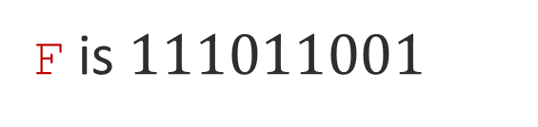
How to convert to IEEE-754
Step 3: calculate the E and F.
    After get the value of E, the final value is exactly the F. Directly get the binary value and ignore the decimal point.
$$111011.001$$
F is $111011001$
$$1.11011001$$
5

Slide 45
How to convert to IEEE-754
Step 4: marge the result of S, E, F.
    Fill in all the result and if there is spaces in F, set all to 0.
    The example is -123.125
S
M
F
$$1 1000 0100 1110 1100 1000 0000 0000 000$$

Slide 46
Double
The size is eight bytes.
Is uses IEEE-754 to store value as well. However, it has more bits in M and F.
Some system has the data type: long double. Its size is 12 bytes.

Slide 47
Char
The size is one byte.
It is not like other data types, it stores a word. It uses a table to represent some words. The table is called ASCII table.
Although char is used to represent words, is still a value. Char can calculate with integer directly.

Slide 48
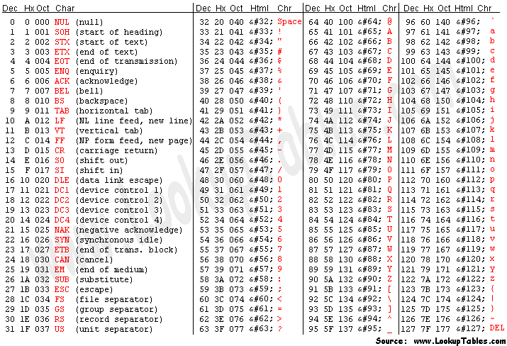
Char
ASCII table:

Slide 49
Char
Ex:
    Char c = ‘A’;
    Char d = c+32;
    printf(“the character is: %c\n”,d);
    printf(“the value is: %d\n”,d);
    The output will be:
    the character is: a
    the value is: 97

